Slide 1
Psychology Meets ML—— A Case Study of Personality Theory
Zhiling Zhang
2021.10
Notes:
Today my topic is “ Psychology Meets ML —— A Case Study of Personality Theory”
I'm recently working on a project at the intersection of psychology and machine learning (online depression detection actually), and I'm also a fan of psychology. During my research and extra readings, I find it interesting that ML and psychology are closely related. Therefore, I'd like to share this talk with you.

Slide 2
Outline
Basics on Personality Theory
Psychology
Validity of Personality Tests
Psychometrics (心理测量学) / Statistics
Massive Prediction of Personality and Its Application
Machine Learning
Notes:
I will cover:
1. Basics on Personality Theory. This is about psychology
2. The validity of personality tests, or How can we check if a psychology test is reliable? This is about psychometrics
3. How can we predict personality massively and utilize them in real world applications? This is about machine learning

Slide 3
Outline
Basics on Personality Theory
Psychology
Validity of Personality Tests
Psychometrics / Statistics
Massive Prediction of Personality and Its Application
Machine Learning
Notes:
First, that’s talk about personality theory

Slide 4
Implicit Theories of Personality
Without learning any personality theory, we naturally have our system of describing a person
Our descriptions are usually in the form of trait tags
honesty, reliability, sense of humor, generosity, outgoing attitude, aggressiveness, moodiness, pessimism, etc.
They can work unconsciously, and decide how we interact with others
Notes:
without Xxx
This is our implicit personality theory. But we may want a more concise and universal theory to describe a person.

Slide 5
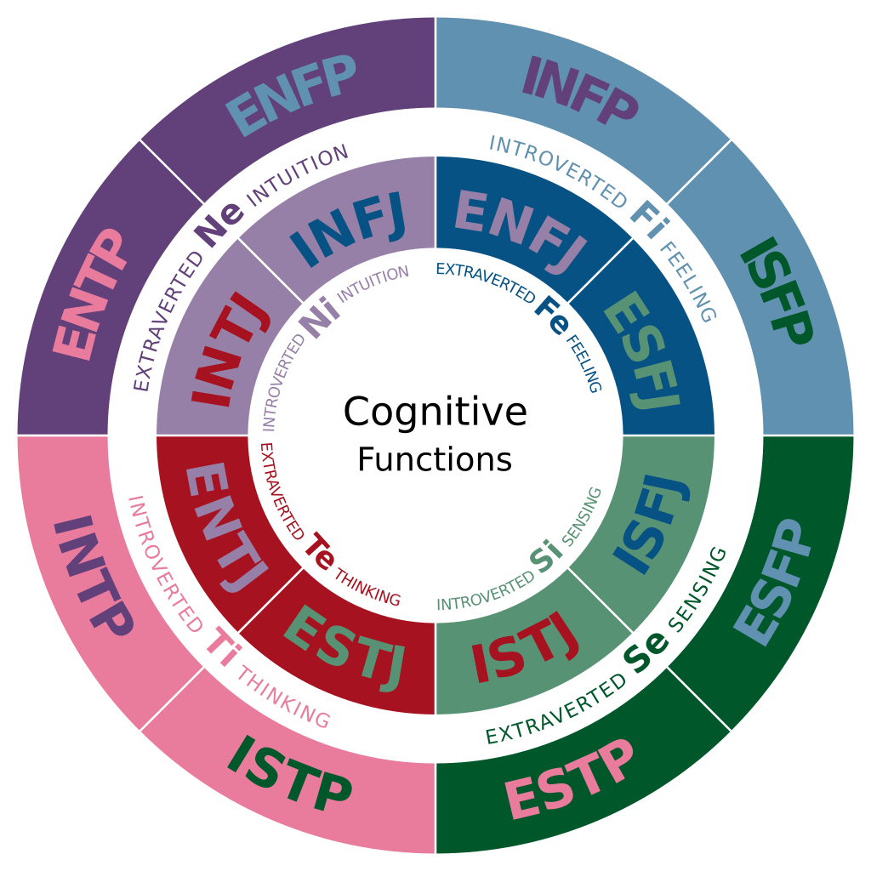
The Myers-Briggs Type Indicator (MBTI)
The most popular personality assessment in mainstream culture
16 personality types on 4 dimensions
Abbreviation of four letters
ESTJ: extraversion (E), sensing (S),
thinking (T), judgment (J)
INFP: introversion (I), intuition (N),
feeling (F), perception (P)
Criticized as pseudoscience!
Psychometrics later
Notes:
Then we have psychology theories like this one, MBTI. It is very famous so I guess many of you may have heard about it.
It is xxx
However, most psychologists actually criticize it as pseudo-science. The theory was established long ago and sounds good at that time, but it can not pass the examination of modern psychometrics.

Slide 6
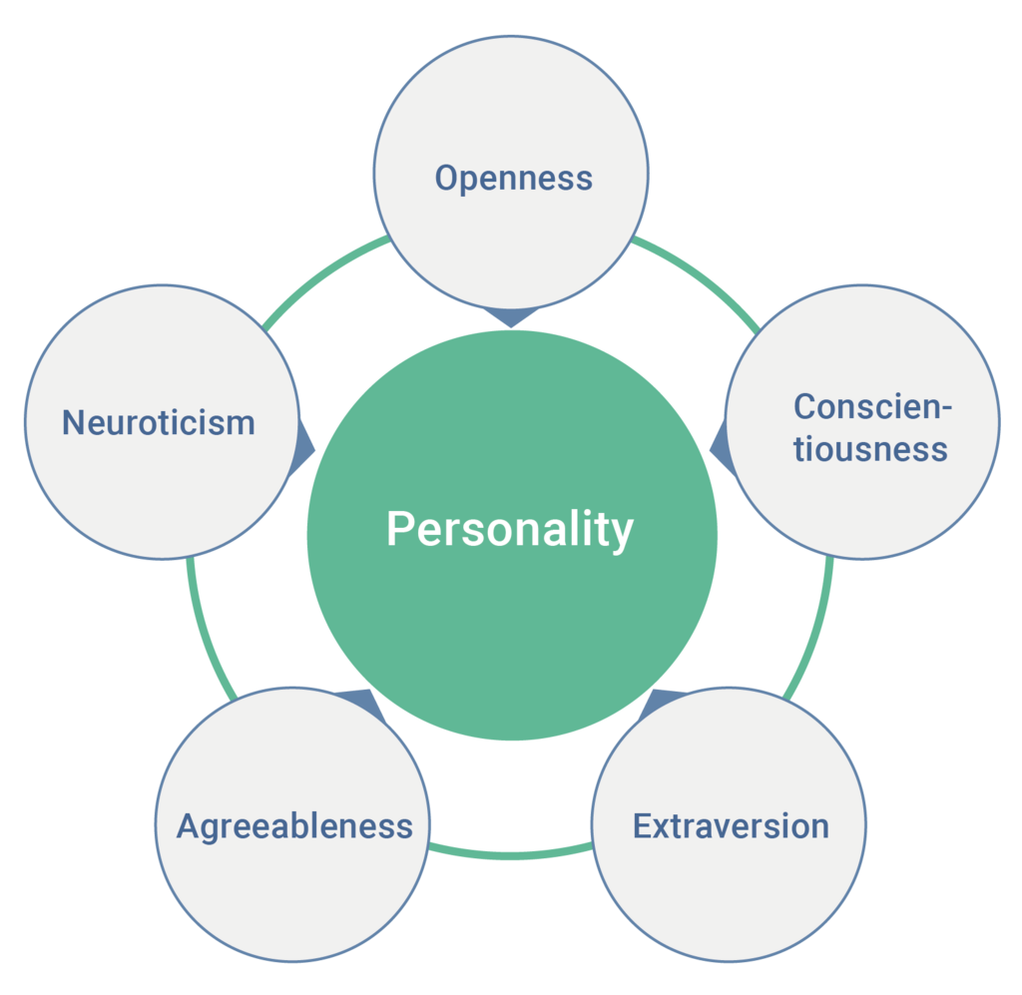
The Big Five Personality Traits
The most widely-acknowledged personality trait taxonomy
Abbreviated as OCEAN
Validity proved in many studies
Use continuous scores instead of discrete types for personality
Allow nuanced differences
Derived from Factor Analysis on personality survey data
Notes:
In contrast, this theory, the big five, is more reliable, and it is the most widely-acknowledged personality trait taxonomy.
It consists of the 5 dimensions as is shown in the picture, so it can be abbreviated as OCEAN.
A crucial difference between the big five and MBTI is that it use continuous scores instead of discrete types for personality. For example, not all open people are equally open, right? MBTI type can’t tell the difference, but the OCEAN score can express this.
Another interesting point is that its derivation is closely related to a machine learning technique called factor analysis, and I will cover this later.

Slide 7
Openness (开放性/探索求知)
A general appreciation for art, emotion, adventure, unusual ideas, imagination, curiosity, and variety of experience
High: curious, creative, engage in risky behavior, …
Low: pragmatic, perseverance, close-minded, …
Notes:
First, let’s take a closer look at the 5 dimensions

Slide 8
Conscientiousness (尽责性/可靠性)
High: reliable, hard-working, organized, …
Low: undependable, lazy, disorganized, …

Slide 9
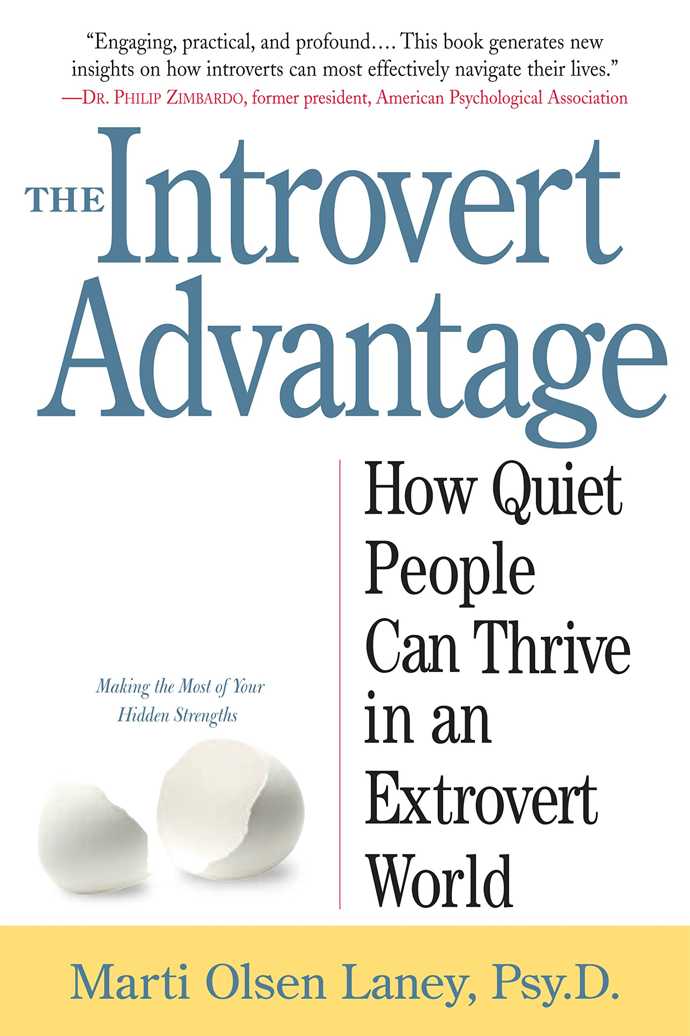
Extraversion (外向性)
High: sociable, talkative, affectionate, …
Low: introverted, quiet, non-excitement-seeking, …
Key difference: Extraverted people gain energy from crowds, while introverted people get them from staying alone
Introversion ≠ hate all socials
😫：too noisy, too many people (esp. strangers)
😊：one-on-one chat, quiet (e.g. watching exhibitions)
Introversion ≠ shyness
Introverts skilled in talking: Lincoln, Putin, Deng Xiaoping, etc.
Notes:
That’s the general view of extraversion and introversion. But I have more on this. (click)
When I was small, I was often criticized for my introversion and shyness, until I’ve read the book “the Introvert advantage”, and it helps me know more about this type of personality.
An interesting point in the book is that, the key difference between xx is that Extraverted people gain energy from crowds, while introverted people get them from staying alone.
So some introverts can even be warm and sociable, but we often need time for ourselves to take as a rest.
Therefore, we don’t hate all socials, but we can have some preferences. XXX
Also not all introverts are shy. Actually, many famous people known for their social skills are introverts, like Lincoln and Deng Xiaoping

Slide 10
Agreeableness (宜人性/随和性)
High: agreeable, sympathetic, forgiving, …
Low: selfish, ruthless, critical, …

Slide 11
Neuroticism (情绪性/神经质)
High: worrying, insecure, nervous, …
Low: calm, secure, at ease, …

Slide 12
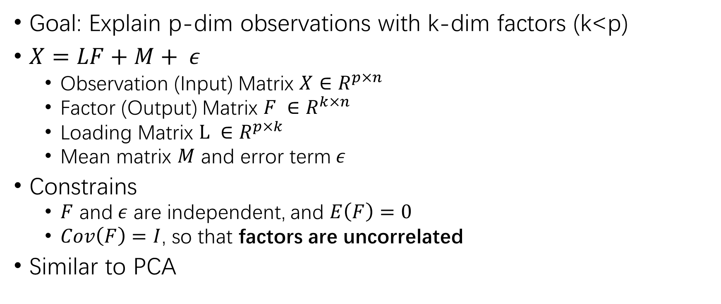
Factor Analysis
Goal: Explain p-dim observations with k-dim factors (k<p)
$X=LF+M+ ε$
Observation (Input) Matrix $X∈R^{p×n}$
Factor (Output) Matrix $F ∈R^{k×n}$
Loading Matrix $L ∈R^{p×k}$
Mean matrix $M$ and error term$ε$
Constrains
$F$ and$ε$ are independent, and $E\left(F\right)=0$
$Cov\left(F\right)=I$, so that factors are uncorrelated
Similar to PCA
Notes:
Now let’s look at the technique behind the theory, factor analysis. I remember I first know this from Mr. Tu Shikui’s Machine Learning course, and he spent a whole lecture on this. I’m not going to introduce all details of the algorithm, but I will just give some brief intuition.

Slide 13
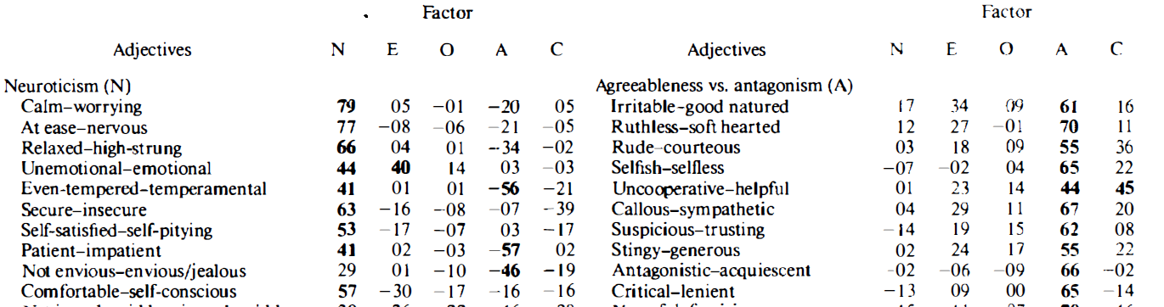
Derivation of the Big Five from FA
Theory hypothesis first: 80 adjectives on 5 dimensions
Experiments then: ask peers to rate others people’s personality on a 80D scale
Analysis Last: Fit a FA model on the 80-dim score matrix
Result: Five factors correlates with the theory well, and can explain most variance
Notes:
Then how can we derive the big five from FA?
First, some psychologists have come up of a hypothesis of big five theory with many adjectives on each dimension.
Then researchers asked peers to rate others people’s personality on a scale consists of these 80 common adjectives.
Then they fit a FA model on the 80-dim score matrix, and find that using 5 factors can explain the most variance of the original 80-dim matrix, and these 5 factors correlate with the original big five theory well.
Therefore, the original hypothesis is verified, and many psychologists further adjust it and design tests according to the result.
Comparing 5 with 80, we can see The Big Five is much simpler in describing a person than our natural implicit theory with much more words. (click)
And the table shows part of the Loading Matrix of the FA model. We can see that the words that are supposed to measure a factor like N, do rate higher on its corresponding dimension, and the correlations with other factors are usually weak. (pointer)
Ref: Validation of the Five-Factor Model of Personality Across Instruments and Observers

Slide 14
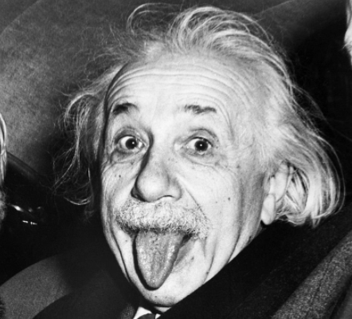
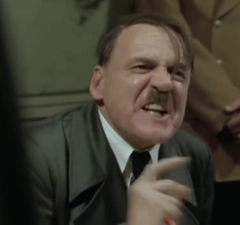
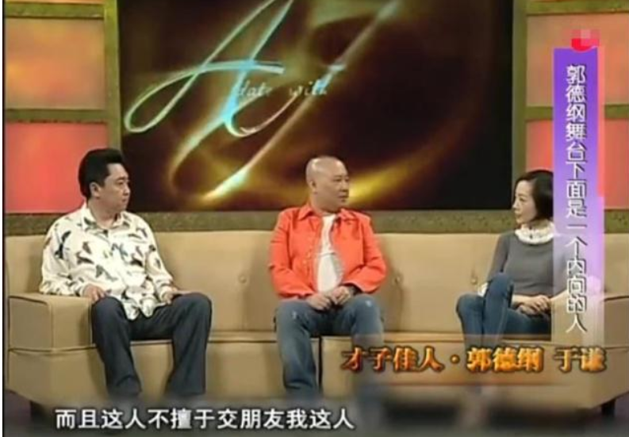
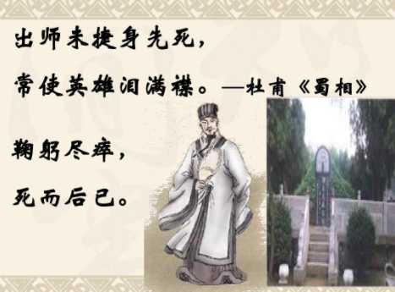

Q: Guess their personality
Einstein’s Openness
Hitler’s Neuroticism
High or Low?
High or Low?
诸葛亮’s Conscientiousness
郭德纲’s Extraversion
High or Low?
High or Low?
Note: O (开放性) C (尽责性) E (外向性) A (宜人性) N (情绪性)
Notes:
More:
Personality types of world’s most powerful celebrities by analyzing their Twitter stream content | Media Managers Club

Slide 15
Findings About Personality
Education
GPA and exam performance are both predicted by Conscientiousness
Neuroticism is negatively related to academic success
Health
Being highly Conscientious may add as much as five years to one's life
Conscientiousness, Extraversion, and Openness were related to lower risk of mortality
Relationship (Engaged couples)
Higher quality for higher partner-reported openness, agreeableness and conscientiousness, and self-reported extraversion and agreeableness
Note: O (开放性) C (尽责性) E (外向性) A (宜人性) N (情绪性)
Notes:
Since we have all passed so many exams and become a student of SJTU, I believe most of you should have a high C.
By the way, I must make a warrant that these reports are rare and not conclusive. So our lives are not decided by our personalities, and we are still the creator of our own lives.

Slide 16
Outline
Basics on Personality Theory
Implicit theory, MBTI, the Big Five (OCEAN)
Openness (开放性/探索求知)
Conscientiousness (尽责性/可靠性)
Extraversion (外向性)
Agreeableness (宜人性/随和性)
Neuroticism (情绪性/神经质)
Validity of Personality Tests
Massive Prediction of Personality and Its Application
Notes:
We’ve introduced the theories, mainly OCEAN. Next, we will see how psychometrics can be used to examine whether a personality test is reliable

Slide 17
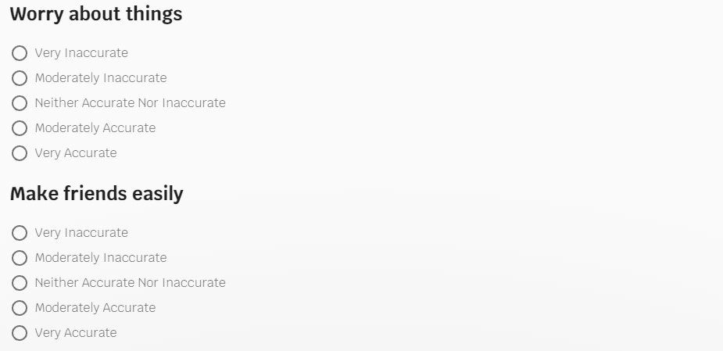
Example test for OCEAN
https://bigfive-test.com/
Rate on 120 personality descriptions (24 per trait)
Notes:
Before discussing the validity of tests, we will first show an example of the test for OCEAN.
https://bigfive-test.com/
Using IPIP-NEO-PI

Slide 18
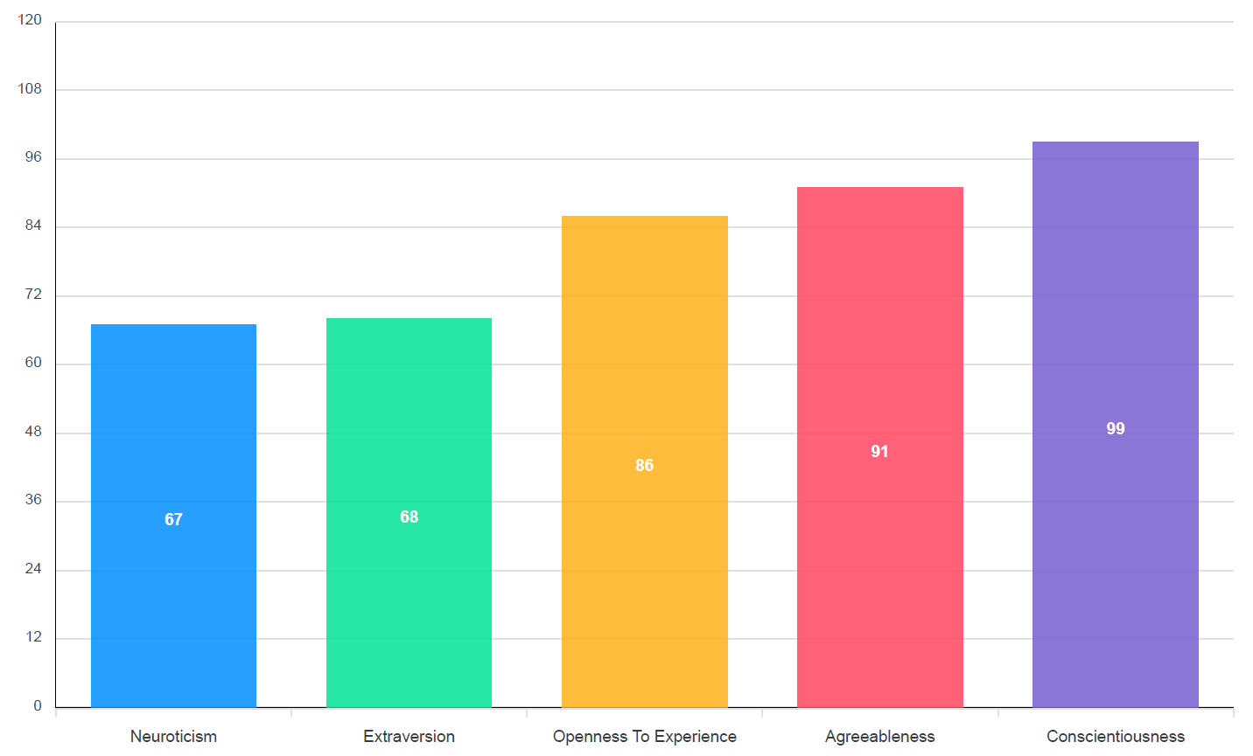
Example Results
N
E
O
A
C
Notes:
The result will be like this. This is actually my test result. Does this matches your impression on me?

Slide 19


Is a measurement valid? (Validity)
Validity is the extent a theory or measurement is well-founded and likely corresponds accurately to the real world
Common pitfalls in a theory or measurement
Claim: Question A and B measures the same trait
Claim: I proposed theory A
that is totally different from B
A
B
Truth:
A
B
Truth:
Claim: Happiness is a stable personality
Claim: All people will agree on this.
An hour
Truth: 👍👎👎👎👍👎👍👍
Truth:
Notes:
Now let’s turn to our question.
A theory or measurement can have a low validity if it falls into some pitfalls, for example. (click)
We uses multiple question to measure a trait. But we may find 2 questions that are supposed to measure the same trait are actually very different, then the test is unreliable.
Next, psychologists may want to establish some new theories to describe new things. But we may find A is actually very similar to another B, then either the theory has some problem so it doesn’t meet the expectation, or it is redundant.
Next, personality is assumed to be stable. So it won’t change in a short period. However, suppose we think happiness is a personality trait, it can easily change. So it is deemed as a emotion instead of personality.
Last, suppose we have established a theory, we usually hope that all people can agree on this, so that we can apply it universally. However, many people can have quite different opinions, so we need to check it carefully.
So how can we spot all these pitfalls? Now we will introduce the effective measures in psychometrics.

Slide 20
Test-Retest reliability
The repeatability of a measurement across time for same raters
Stable traits (e.g. personality): over a month
Short-term conditions (e.g. depression): several days
Correlation or Accuracy between 2 tests across a time-period
Critiques on MBTI (Classification)
50% chance to fall into a different personality category after 5 weeks (Acc)
Reliability of OCEAN (Score)
test-retest correlations were greater than 0.75 (Correlation)
The hard division line might be to blame
Given threshold=5, how different are 5(introverted) and 6(extraverted)?
Notes:
First, we will introduce test-retest reliability. Since personality is stable, a reliable test should give similar results when tested after a certain period.
So the repeatability of a measurement across time can reflect its reliability.
Personality are usually retested over a long time period like month, while short-term conditions like depression are also supposed to be stable at least within several days.
To actually calculate it, we will use Correlation or Accuracy between 2 tests.
Let’s look at the example of MBTI. Since MBTI divides people into 16 classes, we use acc to measure the reliability. And we find that 50% of the participants will get a different result at least on one dimension after 5 weeks. So MBTI received critiques.
For OCEAN, since it uses scores, we use correlation to measure the reliability, and find it is quite good.
I think a main weakness of MBTI is its hard division. It initially has scores, but uses a threshold to divide people into types. So xxx
That’s a weakness
The Big Five Inventory (BFI): Reliability and validity of its Italian translation in three independent nonclinical samples. - PsycNET (apa.org)
A Critique of the Meyers Briggs Type Indicator (recruiter.com)
Myers–Briggs Type Indicator - Wikipedia

Slide 21
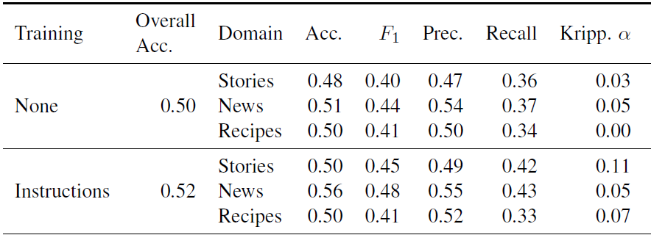
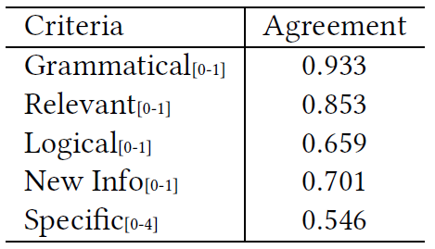
Inter-rater Agreement
The similarity between responses given by different raters
Not applicable to personality tests
Commonly used for examinations
For theory: if a concept can achieve strong consensus (e.g. not controversial or ambiguous)
For measurement: if the instructions are clear or the training is sufficient
(a)
(b)
Diverse and Specific Clarification Question Generation with Keywords, WWW 2021
All That’s ‘Human’ Is Not Gold: Evaluating Human Evaluation of Generated Text, ACL 2021 outstanding paper
Notes:
Next, in contrast to test-retest that focus on one rater, inter-rater agreement is about different raters. It measures the similarity between their responses.
Actually, this is usually not applicable to personality tests, but is commonly used for examinations. For example, I think it can especially important for the high school Chinese exams. I remember that the multiple choices questions in a Chinese exam will always arouse controversy.
(click)
Therefore, inter-rate agreement can reflect if a concept or theory can achieve strong consensus (e.g. not controversial or ambiguous)
For example, in my WWW paper about question generation, I ask annotators to rate on several criteria, and find that logical achieves much lower agreement than grammatical, indicating that the concept of logical is more ambiguous than grammatical.
(click)
It can also show the quality of the measurement like if the instructions are clear or the training is sufficient.
For example, in this ACL 2021 paper, the author studies if human annotators can distinguish a text piece written by human or GPT-3. The authors first found that the accuracy and the inter-rater agreement (alpha) is extremely low, when no training is given to the annotators. Then they tried to give the annotators instructions, and alpha do improve, but the accuracy is still low. It shows that GPT-3 is really strong, but better training does help improve agreement. (pointer)
I am not going to cover the calculation methods like kappa and alpha, you may learn about them at Kenny’s WSM course.

Slide 22
Internal Consistency
We usually use multiple questions to measure the different aspects of the same construct
Response for questions of the same construct are expected to be consistent
Group 1 | Group 2
Am always prepared | Am always prepared
Like order | Insult people
Follow a schedule | Other people's problems
Pay attention to details | Pay attention to details
Which group is more consistent internally?
How can we quantify this?
Notes:
For example, now we have 2 group of questions.
Group1 actually all measures C, while I added 2 questions from A into group2

Slide 23
Split-Half reliability
Split the responses in a group into 2 halves
Calculate their correlation
Group 1 | Response | Group 2 | Response
Am always prepared | 5 | Am always prepared | 5
Like order | 4 | Insult people | 0
Follow a schedule | 5 | Other people's problems | 0
Pay attention to details | 4 | Pay attention to details | 4
Pearson’s r between red and blue half:
Group1: 1.0, Group2: -1.0
Usually make many random splits and calculate the mean
Group1 ≈ 1, Group2 ≈ 0
Notes:
We have many methods to quantify internal consistency, and a common one is split-half reliability.
To calculate this, we split xx . Here, the red questions in each group is a subgroup of 2.
So in this split, we can see group1 is internally positively related, while the other one is negatively related.
But this is not the whole picture, group 2 is actually unrelated instead of negatively related, so we will usually make many xxx
Then we will get result like this, which show that group 1 is more consistent than group 2.

Slide 24
Discriminate Validity
Tests whether different concepts or measurements that are supposed to be unrelated are, in fact, unrelated
E.g. Happiness VS sadness
Another critique on MBTI
Its Introversion score also correlates with Neuroticism (OCEAN)
Fail to discriminates between Introversion and Neuroticism
The dimensions are designed to be different for OCEAN
The uncorrelation constraint in Factor Analysis
Notes:
Different from internal consistency focusing on the same concept, discriminate validity focus on the discrimination between different concepts

Slide 25
Q: Spotting the issues with validity metrics
Claim: Question A and B measures the same trait
Claim: I proposed theory A
that is totally different from B
A
B
Truth:
A
B
Truth:
Internal consistency
Discriminate validity
Claim: Happiness is a stable personality
Claim: All people will agree on this.
An hour
Truth: 👍👎👎👎👍👎👍👍
Truth:
Inter-rater agreement
Test-Retest reliability
Choices: Test-Retest reliability; internal consistency; discriminate validity; inter-rater agreement
Notes:
Here is a quiz for you.
After learning the concepts, can you tell me which of the measurement below can be used to spot which issues? Let’s do a one-to-one matching. (Pointer)

Slide 26
Outline
Basics on Personality Theory
Validity of Personality Tests
Test-Retest reliability; Inter-rater Agreement
Intra/Inter raters
Internal Consistency; Discriminate Validity
Intra/Inter concepts
Massive Prediction of Personality and Its Application
Notes:
We’ve discussed 4 types of measurements for validity from different perspective, like raters and concepts.
Now let’s turn to xx

Slide 27
Limitations of Questionnaires
Inconvenience
Self-bias, dishonesty (自我报告偏差)
Give false response at undesired characteristics like “I tend to be lazy”
Reference-Group Effect
An introvert engineer might think he is extravert if he is surrounded by a group of even more introvert engineer friends
Notes:
* I’d like to share a personal experience on this. During my last internship at ByteDance, I sit at an interesting position, in between 2 different groups of people. At my right hand side, there are my colleagues, mostly introverted, male engineers. The ambient is usually silent except for working discussions. But at my left hand side, there are many interns major in foreign languages, work as language experts. They are mostly extraverted girls, and I can usually hear chats and laughter from them. So, compared to my right, I think I’m ok, but compared to my left, I feel I’m quite introverted.

Slide 28
Automatic Personality Recognition
Predict Personality from text, multimedia, behaviors of a user
Advantage
Objective
Scalable
Approach: Machine Learning
Notes:
So now we have automatic personality recognition. It can xxx

Slide 29
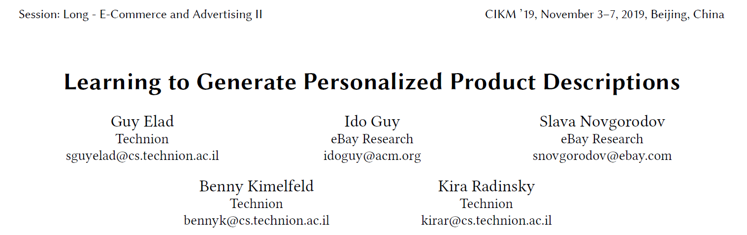
Notes:
I’m going to introduce a typical work on this, a CIKM 19 work from Technion and eBay Research.
The authors want to generate product descriptions for each personality type to provide the personalized experience.

Slide 30
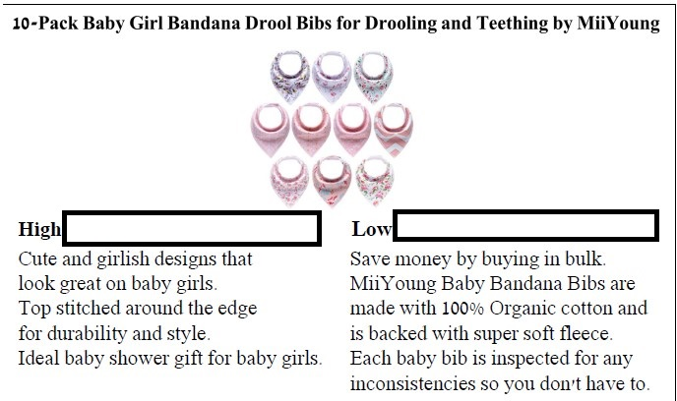
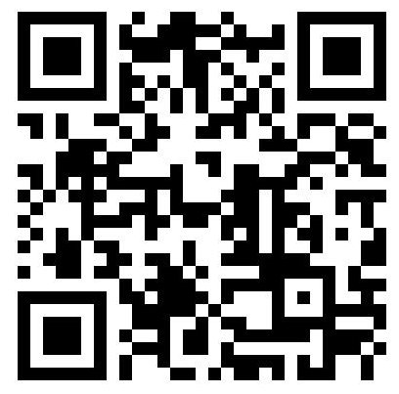
Which one do you prefer?
Notes:
Since the authors claim that their personalized product description will be more attractive for people with certain personality, I’d like to check if it is true.
So I want you to participate in this survey, report your personality and your preference on the descriptions, and we will check if their claim holds.

Slide 31
Personality Prediction
Participants: 447 people recruited from crowdsourcing platform
Label: Answer the 44-question version of the Big Five Inventory personality test (BFI-44)
Change Score into Class (High/Low) according to 70/30 percentile
Model: LR, XGBoost
Feature set:
Purchase History
Product price statistics
Temporal patterns
Product category distribution
Title of purchased products
Notes:
Let’s come to their approach. To predict personality, we first need a dataset.

Slide 32
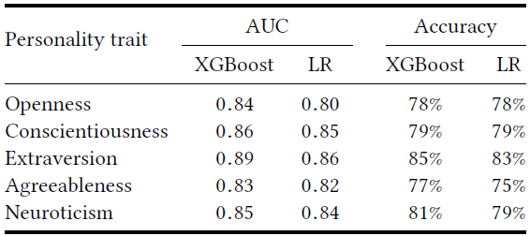
Personality Prediction (Results)
Typical personality inclination (High/Low) can be relatively accurately predicted from e-commerce behaviors

Slide 33
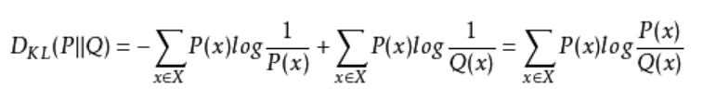
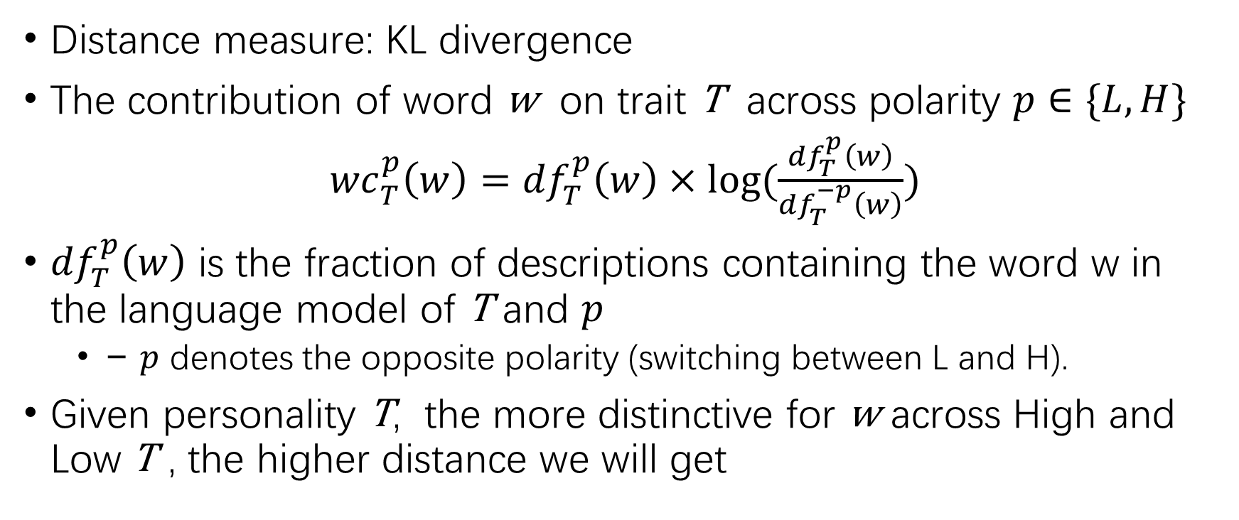
Personality-Distinctive Terms
Distance measure: KL divergence
The contribution of word w on trait T across polarity $p∈\{L, H\}$
${wc}_{T}^{p}\left(w\right)=$ ${df}_{T}^{p}\left(w\right)×log⁡(\frac{{df}_{T}^{p}\left(w\right)}{{df}_{T}^{−p}\left(w\right)})$
${df}_{T}^{p}\left(w\right)$ is the fraction of descriptions containing the word w in the language model of T and $p$
− $p$ denotes the opposite polarity (switching between L and H).
Given personality T, the more distinctive for w across High and Low T , the higher distance we will get
Notes:
Then they want to find personality-distinctive terms. To describe the distinction, they use a distance measure, xxx
(pointer)

Slide 34
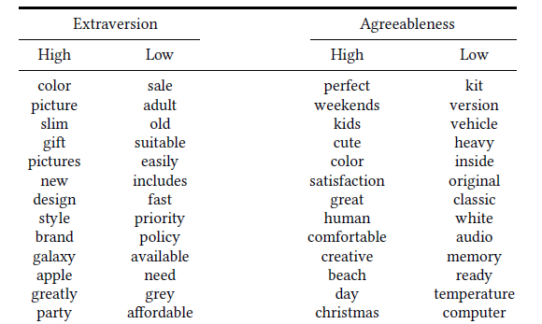
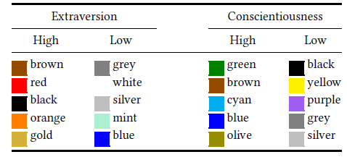
Personality-Distinctive Terms (Findings)
Notes:
This table shows their findings.
Specifically, they also take the unigrams describing colors, and find the colors that people with different personality will prefer.
* I have also put these examples in my survey, does their findings matches your preference? At least, it makes sense to me, and you may tell this from my dressing

Slide 35
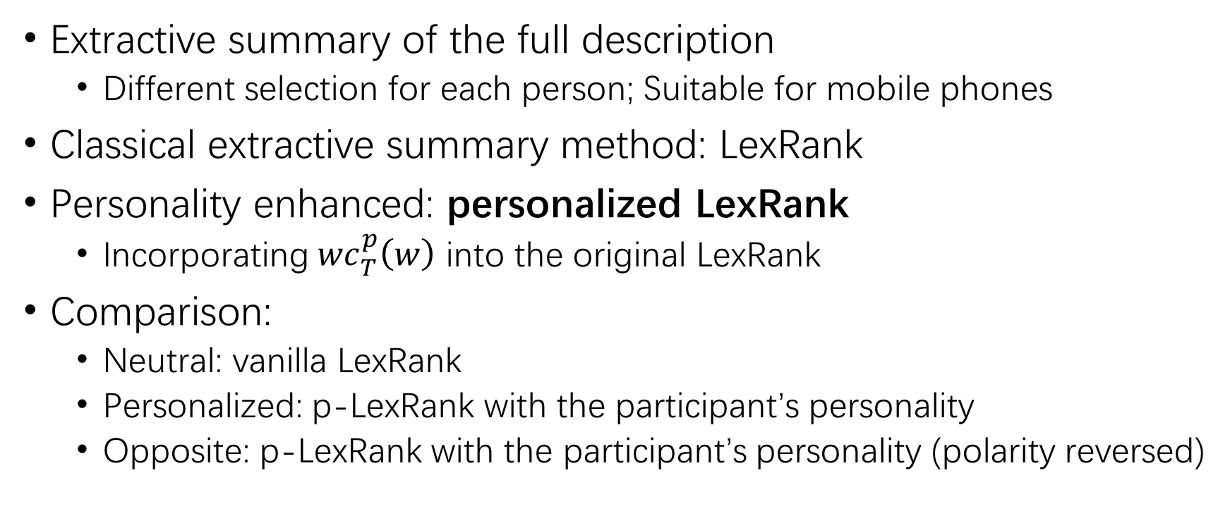
Personality-based Description
Extractive summary of the full description
Different selection for each person; Suitable for mobile phones
Classical extractive summary method: LexRank
Personality enhanced: personalized LexRank
Incorporating ${wc}_{T}^{p}\left(w\right)$ into the original LexRank
Comparison:
Neutral: vanilla LexRank
Personalized: p-LexRank with the participant’s personality
Opposite: p-LexRank with the participant’s personality (polarity reversed)
Notes:
Then they leverage the previous findings to produce personality-based product description
They actually use extractive summary for this, so it can produce different results for different person, and also be concise enough to show on mobile phones.
Xxx
To confirm the effect of personalized-LexRank, they compare the following 3 settings.

Slide 36
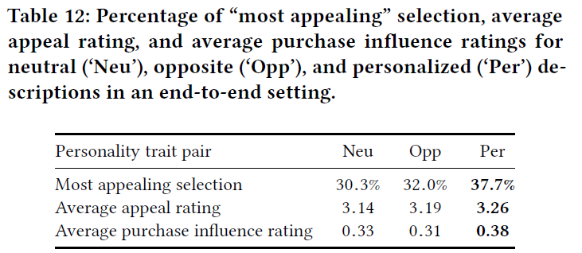
Personality-based Description (Result)
Personalized descriptions are usually considered most appealing among the three, rated higher, and influences purchase
Advantage not “significant” enough, though statistically p < 0.05
Notes:
Pointer

Slide 37
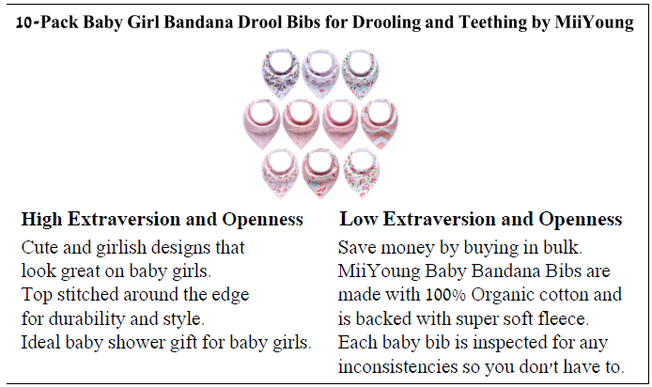
Personality-based Description (Example)
Do you agree with their findings?

Slide 38
Conclusions
Personality Psychology
Implicit theory, MBTI, the Big Five (OCEAN)
Psychometrics
Test-Retest reliability; Inter-rater Agreement
Internal Consistency; Discriminate Validity
Application of massive personality prediction
Personalized product description
(Not mentioned) Recommendation, Dialogue system, etc.

